Slide 1


Green Pace
Security Policy Presentation
Developer: Martin Richardson

Slide 2

OVERVIEW: DEFENSE IN DEPTH
This policy goes over the core security principles, C/C++ core security principles. Our security policy was developed to address evolving cyber threats and ensure compliance with regulatory standards. It supports defense-in-depth by implementing layered security measures, such as firewalls, encryption, and access controls, to protect against breaches at multiple levels.

Slide 3
THREATS MATRIX
The highest priority threats should be prioritized.
The low threats should not be disregarded but take less of a priority.
Likely STD-001-CPP STD-003-CPP STD-010-CPP STD-002-CPP | Priority STD-003-CPP p18 STD-001-CPP p12 STD-010-CPP p9
Low priority STD-006-CPP p1 STD-008-CPP p3 STD-008-CPP p3 | Unlikely STD-006-CPP STD-008-CPP STD-009-CPP

Slide 4
10 PRINCIPLES
Validate Input Data
Heed Compiler Warnings
Architect and Design for Security Policies
Keep It Simple
Default Deny
Adhere to the Principle of Least Privilege
Sanitize Data Sent to Other Systems
Practice Defense in Depth
Use Effective Quality Assurance Techniques
Adopt a Secure Coding Standard

Slide 5
CODING STANDARDS
Do not define a C-style variadic function
Do not depend on the order of evaluation for side effects.
Do not attempt to create a std::string from a null pointer
Do not log unsanitized user input
Allocate sufficient memory for an object
Use a static assertion to test the value of a constant expression
Handle all exceptions
Catch exceptions by Ivalue reference.
Obey the one-definition rule
Do not delete a polymorphic object without a virtual destructor

Slide 6
ENCRYPTION POLICIES
Encryption in rest – Encryption in rest protects stored data. This may include hard drives, phones, computers, and cloud assets, among others. Protection of this data can be done through encryption tools, disk encryption and security for mobile devices and computers.
Encryption at flight – Encryption at flight is about protecting data that is moving. This can be between two devices within a network or moving outside of a network. This can be protected through examples such as email encryption, DLP solutions, and solid network security features, such as firewalls and authentication. It is also important to consider the path data may be taking, and the security of this path.
Encryption in use - Encryption in use protects data that is created, edited, or otherwise defined as in-use. Protection of this data can be done by ensuring data control and protection exists prior to use, and in place in the first place. Managing access rights and identity will also minimize risk to this data.

Slide 7
TRIPLE-A POLICIES
Authentication – Authentication is the act of confirming one’s identity. This can cover a range of types, but often are examples such as static passwords, one-time passwords, certifications, and biometric credentials. These forms of identification work to ensure a person is who they claim to be.
Authorization – Authorization specifies the access rights and privileges of a user, and are an important part of information and computer security. Where authentication confirms an identity, authorization determines what a user can and cannot access in the first place, limiting possible vulnerabilities when someone may interact with sensitive data they may not need to access, or the permissions one may have during access.
Accounting – Accounting is the process of keeping track of activity while interacting with a system, showing timestamps, accessed resources, and data transfer information. This is valuable in both creating a “bread crumb trail” in user activity, and also for the purposes of forensic analysis and investigation, should it be required.

Slide 8
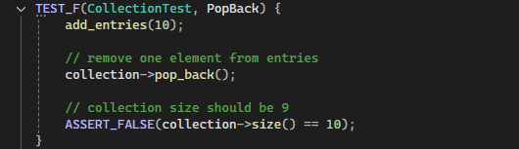
Unit Testing Pop Back

Slide 9
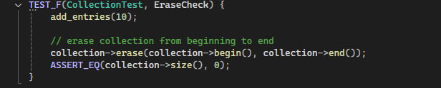
Erase Check

Slide 10
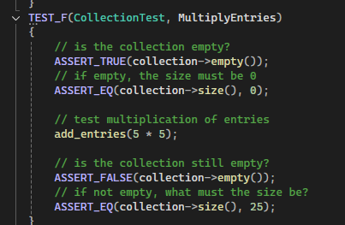
Multiply Entries

Slide 11
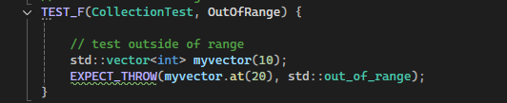
Out Of Range

Slide 12

AUTOMATION SUMMARY
Automation will be used for the enforcement of and compliance to the standards defined in this policy.
In the production phase, we may automate penetration tests.

Slide 13
TOOLS
The DevSecOps pipeline integrates security practices into every stage of the development lifecycle, from planning and coding to testing, deployment, and maintenance. By automating security checks, such as vulnerability scanning and compliance testing, DevSecOps ensures that security is continuously enforced without slowing down the development process.
Tools for Automation:
Parasoft C/C++test - is an automated testing tool that helps ensure the reliability, security, and compliance of C and C++ code by providing static analysis, unit testing, and runtime error detection capabilities.
LoadNinja - is a cloud-based performance testing tool that allows users to create, execute, and analyze load tests for web applications without the need for complex scripting.
Logentries - is a cloud-based log management and analytics tool that collects, analyzes, and visualizes log data in real-time to help monitor, troubleshoot, and optimize system performance and security.
Intruder - is a cloud-based vulnerability scanning tool that identifies security weaknesses in your systems and applications by performing automated security checks. It should be used in the DevSecOps pipeline during the testing phase, after code deployment, to ensure that any potential vulnerabilities are caught before the application goes live.

Slide 14
RISKS AND BENEFITS
Pros
Comprehensive Security Coverage
Automation of Security Controls
Adherence to Best Practices
Compliance and Risk Management
Regular Audits and Reviews
Cons
Complexity
Development Overhead
Potential for Resistance
Cost
Conclusion:
The Green Pace Secure Development Policy offers a strong security framework that aligns with industry best practices and ensures compliance with regulatory standards. However, its complexity and resource requirements may present challenges for implementation, especially in terms of cost and potential resistance from development teams. While effective, the organization must weigh these factors before fully committing to this policy.

Slide 15
RECOMMENDATIONS
Lack of Comprehensive Incident Response Plan
Description: The policy touches on defense strategies and automation but does not explicitly mention a detailed incident response plan (IRP). A strong IRP would ensure timely identification, containment, and recovery from security incidents.
Gap: Without a defined IRP, the organization may struggle to respond effectively to breaches, leading to longer downtime and greater impact.
Weak Focus on Data Privacy Controls
Description: While the policy covers encryption at rest, in flight, and in use, there is no clear mention of how personal data and privacy are managed beyond encryption.
Gap: To fully comply with privacy regulations like GDPR or HIPAA, there should be more emphasis on how sensitive data is handled, stored, accessed, and deleted, including data minimization and anonymization techniques.
Over-reliance on Automation Without Human Oversight
Description: The policy heavily emphasizes automation for security enforcement, such as automated testing and vulnerability scanning. However, automated systems can fail or overlook sophisticated threats that require human judgment.
Gap: Relying too much on automation without regular human review could leave gaps in identifying and mitigating complex threats.

Slide 16
CONCLUSIONS
Keep it simple
Use correct integer precisions
Do not confuse narrow and wide character strings and functions
Handle all exceptions
Validate Input data
Default Deny
Sanitize Data
Follow and review defense in depth strategies and understand the security policy

Slide 17
REFERENCES
Microsoft Security Development Lifecycle. (n.d.). Retrieved from https://www.microsoft.com/en-us/securityengineering/sdl
(N.d.-a). Retrieved from https://dodcio.defense.gov/Portals/0/Documents/Library/DoD Enterprise DevSecOps Strategy Guide_DoD-CIO_20211019.pdf

